Slide 1
Implement the classification model using clustering for the following techniques with Hierarchical Clustering with Test Score, and Confusion Metrics.
ML Practical – 7 A

Slide 2
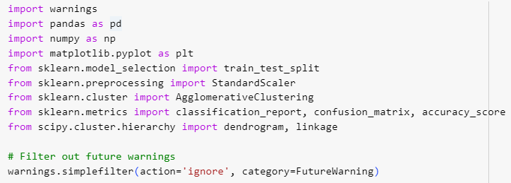



Slide 3





Slide 4





Slide 5
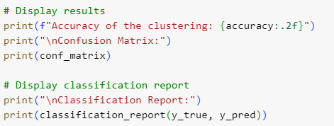


Slide 6




Slide 7



Slide 8
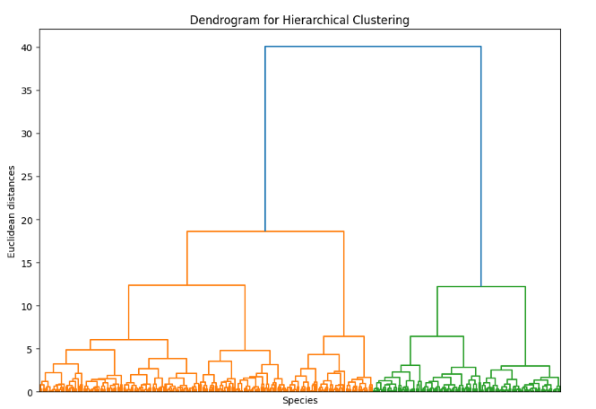

Slide 9
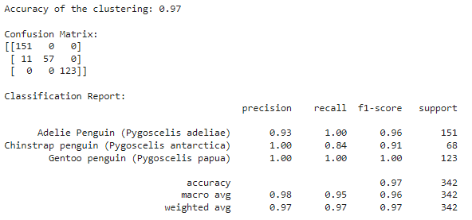
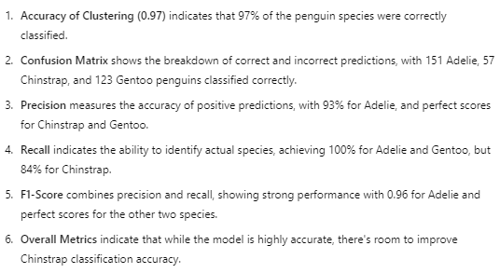

Slide 10
Implement the rule-based method and test the same.
ML Practical – 7 B

Slide 11





Slide 12

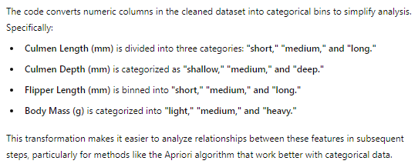

Slide 13

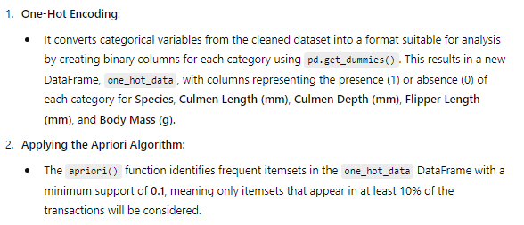
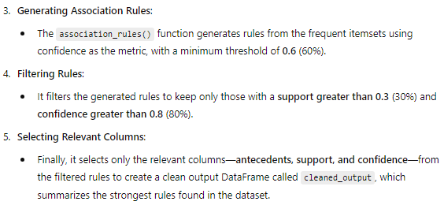

Slide 14

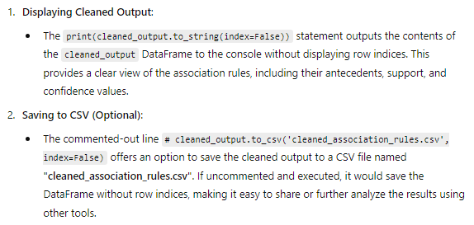

Slide 15



